Slide 1


DSA8023 Analytathon 1
Suspected EV Customer Challenge

Slide 2
Performing EDA
Analysis of excel sheet and importing into code
The data contains 186558 rows and 24 columns.
There are 7 Categorical columns and 13 Numerical columns and 4 with datetime data type.
Perform EDA
Checked missing values
:- ContractStartDateEV - 184042
:- ContractStartDate - 577
:- ContractEndDate - 967
:- mosaicType - 42522
Check duplicate rows
:- There are 250 duplicate rows
Check for Outlier
Data distribution – checked using mean, mode, median
Data trends

Slide 3
Working with data
Treat Null values using Mode, Median, Mean.
Checked skewness by plotting histograms and used median to fill missing values.
Visualization of all bill columns
All columns are right skewed
Filling missing values in bill columns
Filled previous non-zero value in place of zero between two non-zero values in a row.
Keeping only ‘EV’ and all the ‘Bills’ columns in the dataframe. Because I want to build model which predict ‘EV’ is ‘Y’ or ‘N’, bills columns for analysing changes in bills.

Slide 4
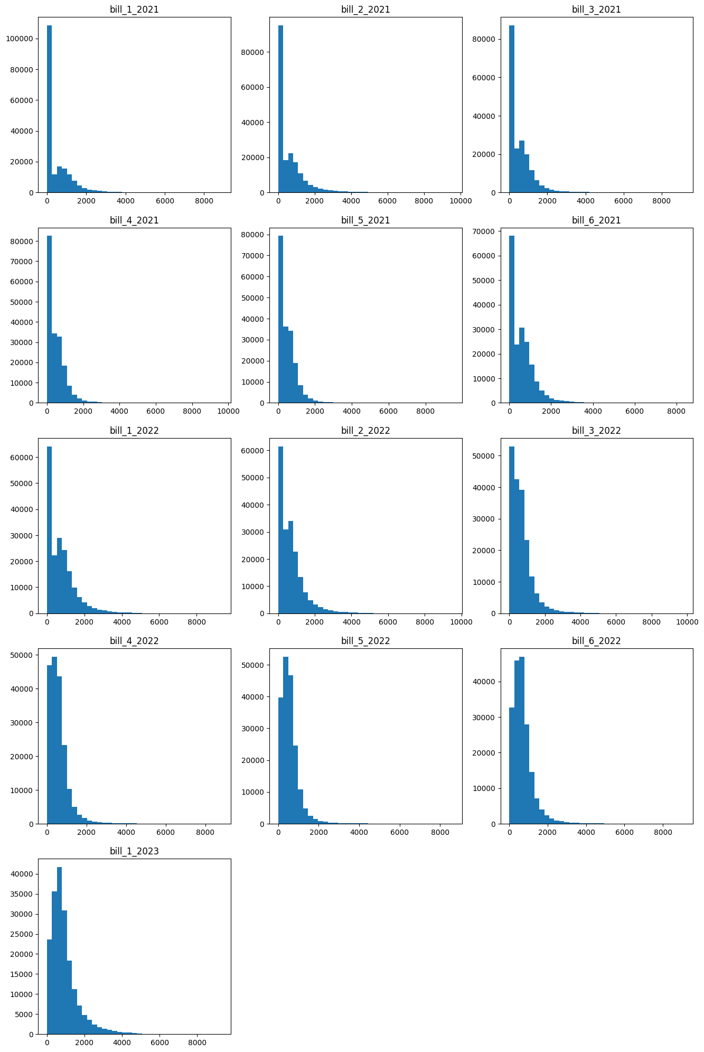
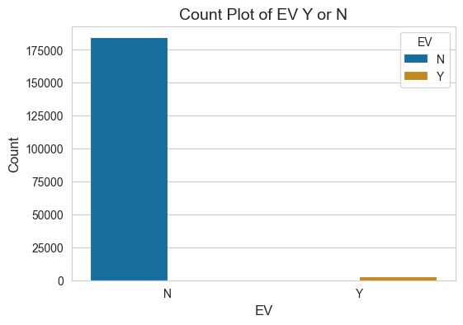
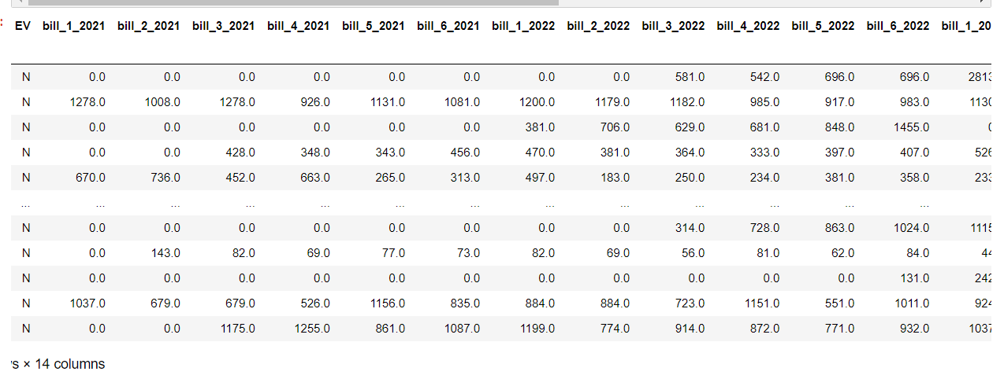
Visualization of dataframe and columns

Slide 5
Model building
In EV column data is Biased towards ‘N’ as in EV column Number of Y is: 2510, Number of N in EV column is: 183798.
To balance this data I used ‘Oversampling’ technique. It increases the count of minority class equal to the majority class, so that our model can train on unbiased data.
After performing oversampling there are equal values of Y and N in EV column.
Model Building :-
Splitting data in train and test data and the models which I have created are as follows.
KNN (k-Nearest Neighbors)
Decision Tree

Slide 6
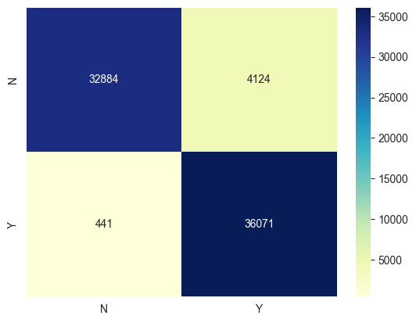
KNN (k-Nearest Neighbors)
Is is a basic machine learning algorithm that can be utilised for both classification and regression issues. With the KNN algorithm, fresh data points are classified according to how closely they match training data points.
After performing the knn model on data I am getting the following results.
Observations :-
Accuracy: 0.93
Precision: 0.89
Recall: 0.98
F1 score: 0.94
Kappa score: 0.87

Slide 7
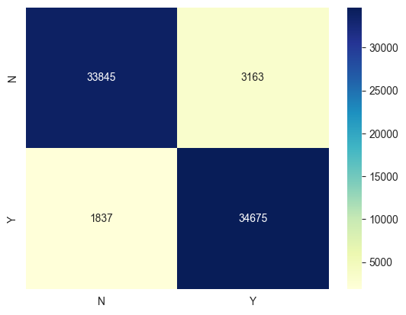
Decision Tree
can be applied to tasks involving regression and classification. It is a tree-like model where each leaf node represents a class name or a numerical value, and each inside node represents a test on an attribute.
After performing this model on data I received following observations.
Accuracy: 0.93
Precision: 0.91
Recall: 0.94
F1 score: 0.93
Kappa score: 0.86

Slide 8
Conclusion
KNN Model – The accuracy of the K-Nearest Neighbours (KNN) model is 93.79%, meaning that 93.79% of the instances were properly classified. When it predicts a positive instance, it is accurate 89.74% of the time, according to its precision rating. Recall is 98.79%, meaning that 98.79% of all positive events in the dataset were correctly detected by the model. The F1 score, is 94.05%, indicating overall strong performance. The distribution of the model's true positive, true negative, false positive, and false negative predictions are displayed in the confusion matrix. The high Kappa score of 87.59% shows that predictions and results accord strongly. Overall, the KNN model does well at correctly identifying instances of positivity.
Decision Tree Model - With a 93% accuracy rate, this model has properly identified 93% of occurrences. Its accuracy in predicting good events is 91%, which means that 91% of the time, it is right. Recall of 94% means that 94% of the positive instances in the dataset were properly identified by the model. The harmonic mean of precision and recall, or the F1 score, is 93%, indicating overall strong performance. The Kappa value is 86%, which indicates a high level of agreement between expected and actual outcomes. The Kappa score assesses the agreement between projected and actual outcomes, corrected for chance. Overall, this model does a good job of correctly recognising instances of positivity and has excellent agreement between projected and actual results.

Slide 9
Thank You

